Slide 1
The Alba Rohrwacher File between Regional Perspectives and Transnational European Cinema
ROY MENARINI
UNIVERSITY OF BOLOGNA

Slide 2
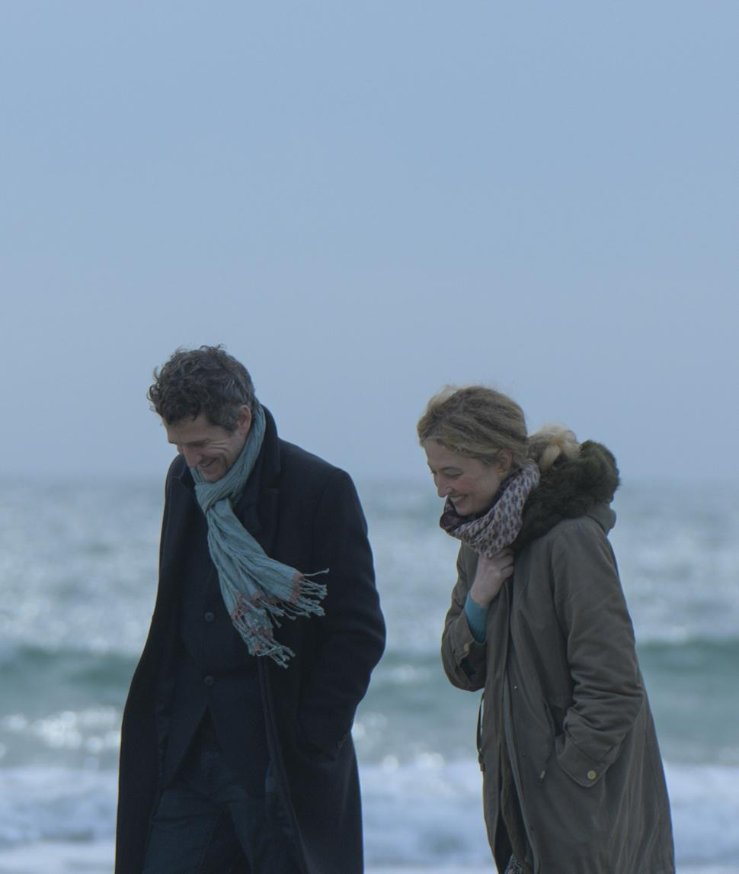
VOICES AND LANGUAGES
Roles performed in French (Hors-saison, Brizé 2023), English (Hungry Hearts, Costanzo, 2014), German (Glück, Dorrie 2012), Albanian (Vergine giurata, Bispuri 2015) or to vary the regional characteristics of italian cinema through character roles, e.g. Emilian (L'uomo che verrà, Diritti 2012), Neapolitan (L'amica geniale, 2018-2024), Sicilian (Via Castellana Bandiera, Dante 2013)

Slide 3
HOW TO DEFINE ROHRWACHER’S PERSONALITY
The definitions used by critics are "eccentric, exotic, foreign, nonconforming, singular, alien, elusive, enigmatic."
That is, these are adjectives that choose not to choose, declaring a kind of impossibility in fully deciphering the symbolic and performative characteristics of the actress. Still "in the Italian cinema of the last 20 years, often made up of interchangeable actors who tended to repeat the same part over and over again, R. is the most elusive and unclassifiable [...] the one who in the physical and inner reinvention of each interpretation has built her path as an actress." (Pedroni 2019)

Slide 4
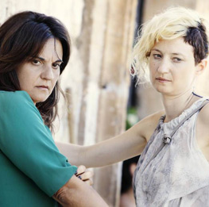
SELF-DEFINING
Of Emma Dante she says, "I was afraid of what Emma saw in me, something I knew I had but could not recognize. Emma made me uncomfortable to myself”.
Again (we emphasize the rhetoric of the titanic effort of the actor's work, according to an ideological element of the contemporary arthouse actor, Jandelli 2012): "She transmitted to me the discipline that the actor must have: to work means to sacrifice oneself, to immolate oneself for a cause, to concentrate hours and hours on the body, on the text, on the sense of what one is seeking without sparing”.

Slide 5
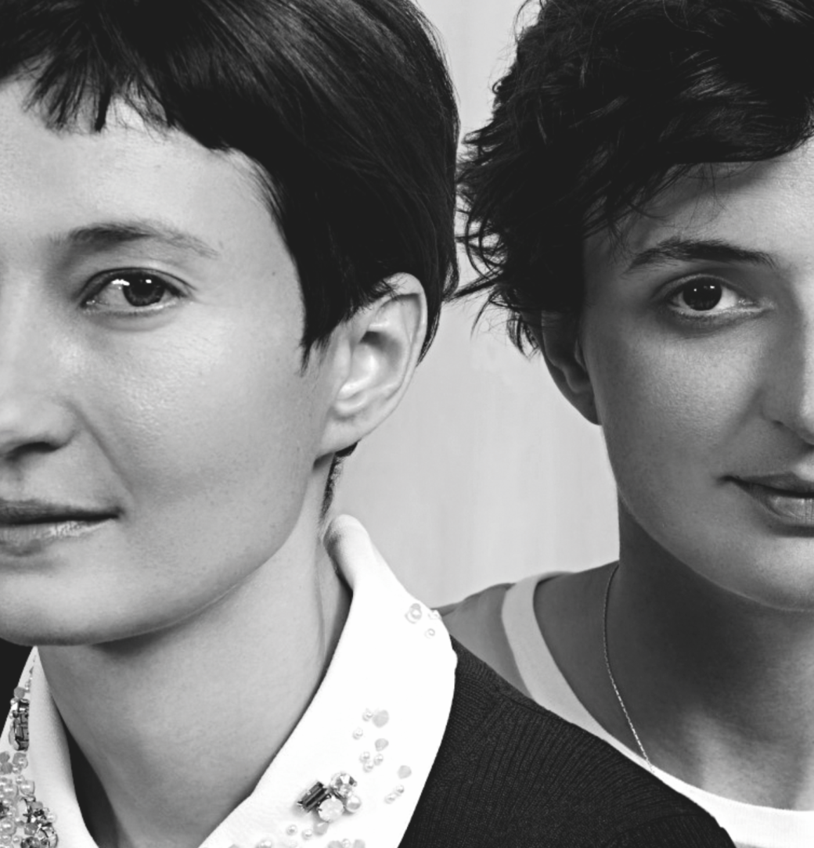
AUTEUR (THEORY) AND ROHRWACHER
Rohrwacher's filmography and directors of reference:
Alice Rohrwacher, her sister (3 films + 1 Oscar-nominated short),
Saverio Costanzo (her husband, 2 films and 2 TV series), Marco Bellocchio (5 films and Bobbio School training)
The elite of Italian auteur cinema (Moretti, Luchetti, Guadagnino, Soldini, Garrone, Dante, Mazzacurati, Avati, Diritti....)

Slide 6
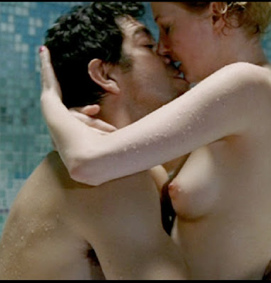
WORK ON THE BODY
Among the actions of affirming her artistic personality and cultural capital, there are also the stages of work on the body and language: the decision to act in particularly erotically daring scenes (Cosa voglio di più, 2009), the physical preparation for acting as a girl with an eating disorder (La solitudine dei numeri primi, 2010), and the various dialect studies mentioned earlier. (Menarini, 2022)

Slide 7
AUTEUR THEORY AGAIN
We are thus dealing with an actress fully embedded in the art-house context and with a vision of the actor's work that is absolutely focused on the artistic and poetic aspect of the craft, with the undisputed role of the author as the absolute coincidence of screenwriter, director, character creator and director of actors-as demonstrated in every interview in which Rohrwacher cites her directors as absolute leaders of her performance or figures of reference for her dialogue.

Slide 8
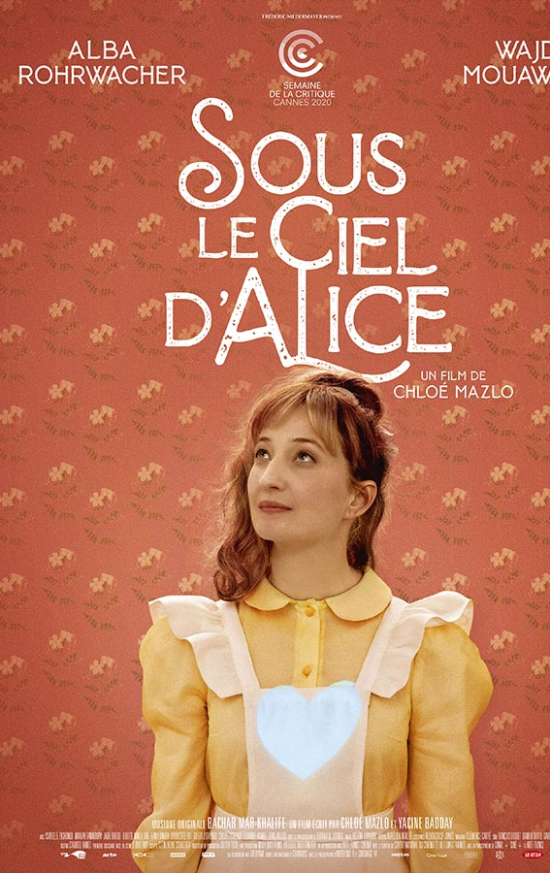
TRANSNATIONAL TURN
At a certain point Alba Rohrwacher has tried-in an uncommon effort among actresses of her generation-to escape the national career typology, which is strongly tied to local productions.
The attempt to overcome the barriers of the national product took place along two main lines: on the one hand the characteristics of the circulation (and demand) abroad of Italian cinema and on the other hand through the phenomena of European productions and co-productions.

Slide 9
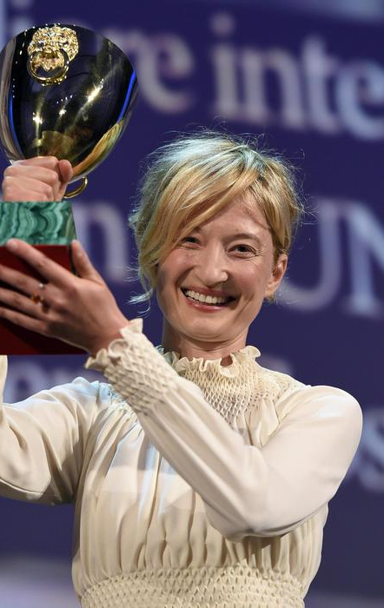
NATIONAL CINEMA: FESTIVALS AND AWARDS
The first is characterized by films that have a "transnational" appeal and are consumed by niche audiences of various sizes in urban arthouse cinemas. In the context of Italian cinema, this is a possible path thanks mainly to the promotional function of international awards (Holdaway, Scaglioni 2018)
The presence at festivals - with the well-known choices of cultural capital managed through the taste of art film - is necessary for the construction of the actor image, which is also very much linked to the awards (2014 - Coppa Volpi for Best Female Performance for Hungry Hearts, plus 2 awards and 7 nominations for the David di Donatello).

Slide 10
ITALIAN CINEMA’S LEGACY
On the other hand, elements of enhancing the co-productive possibility or export potential of Italian cinema are brought to bear: either films shot abroad or actual co-productions or in any case international casts, in a circuit built up both through their own direct relationships and through agencies and through regular auditions. (Armocida, Minuz 2016; Morreale 2022)
No stranger to this delicate balance of national and transnational actress is the recent evocation of italian stardom, particularly the divas of the past best known abroad. In Mi fanno male i capelli (Torre, 2023) she plays a depressed woman convinced she is Monica Vitti; in Finalmente l'alba (Costanzo, 2023) she plays Alida Valli directly.

Slide 11
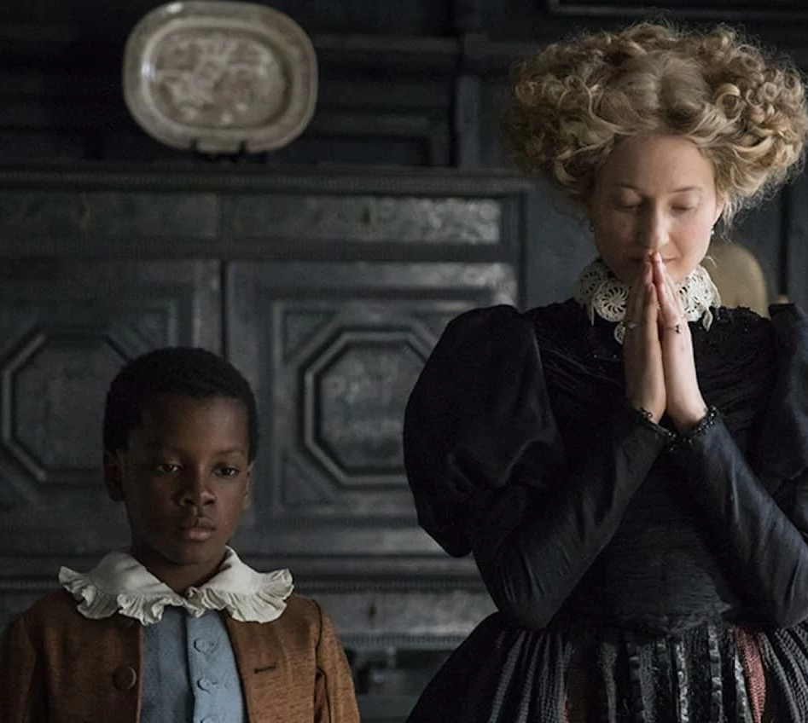
TRANSNATIONAL CINEMAS: virtuosity in speaking foreign languages
In a tradition particularly disinclined to linguistic cosmopolitanism (that of Italian actors, and not only on screen: look at an anthology of Oscar acceptance speeches in English by Fellini, Benigni, Sorrentino and others), Rohrwacher imposes a new agency and raises the level of actorly preparation and language training useful for facing the new challenges of the globalized product.

Slide 12
TIMELESSNESS OF FACE AND BODY
Ranging from her 22-23 years of age to her recently turned 45 years of age, we do not notice particularly significant evolutions with respect to the age of the characters.
Certainly, the teen ager daughter roles of some of the early films are foreclosed, but many of her characters seem to confirm this expressive lunarity that subtracts anagraphic references from her somatic and proxemic features (as can be seen from this collection of photos taken from different stages of her fillmography), very often playing women who are lonely or unattached to traditional family roles.

